Slide 1


DS-NYC-13 Capstone 1
NYC Legally Operating Business Analysis
-Hang Yin

Slide 2

0
Biography
Master’s in Statistics from Cornell University
Veteran of U.S. Army
Data Scientist since 2020
Outside interest: Cooking, baking, and playing basketball

Slide 3
01
Data Information
Data Gathering
Data Cleaning
Data Visualization

Slide 4

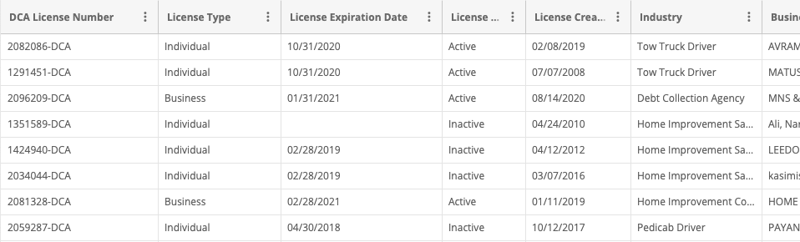
Data Information - Data Gathering
Data set downloaded from NYCOpenData website
Raw data size: 62.2 MB with 27 features and around 266,000 observations
New York City DCA(Department of Consumer Affairs) Issued Licenses from 2003 to 2020(present)

Slide 5
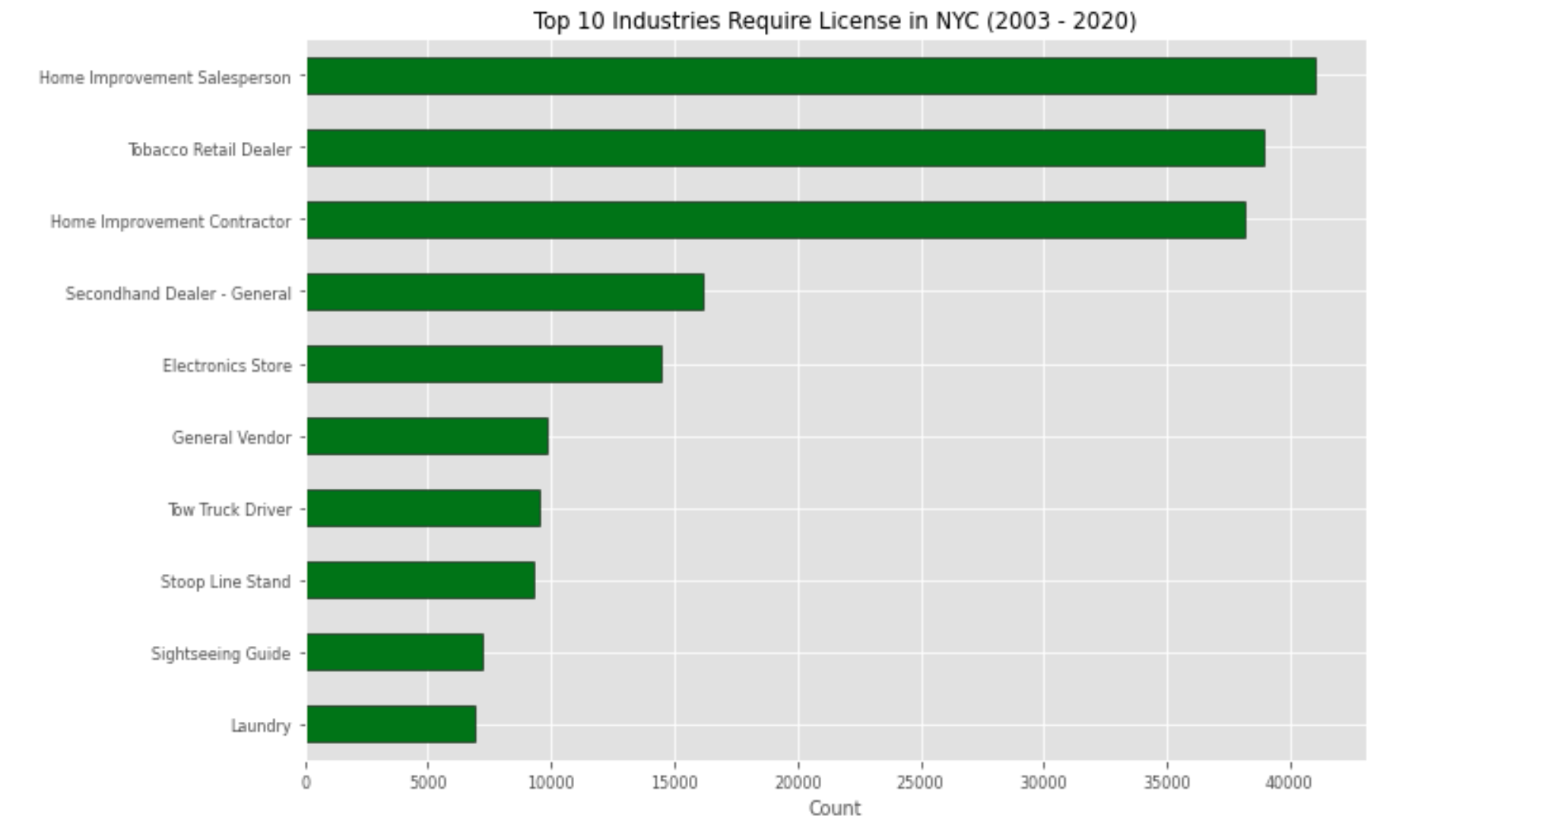
Data Information - Data Understanding
文字内容
文字内容
文字内容
Please replace text, click add relevant headline, modify the text content, also can copy your content to this directly.
Please replace text, click add relevant headline, modify the text content, also can copy your content to this directly.
Please replace text, click add relevant headline, modify the text content, also can copy your content to this directly.

Slide 6
Data Information - Data Cleaning
Focus on new license created of the past three years (2018, 2019, 2020)
Narrowed down to the month of April to September for further analysis
Transformed into Pandas Dataframe with selected features

Slide 7
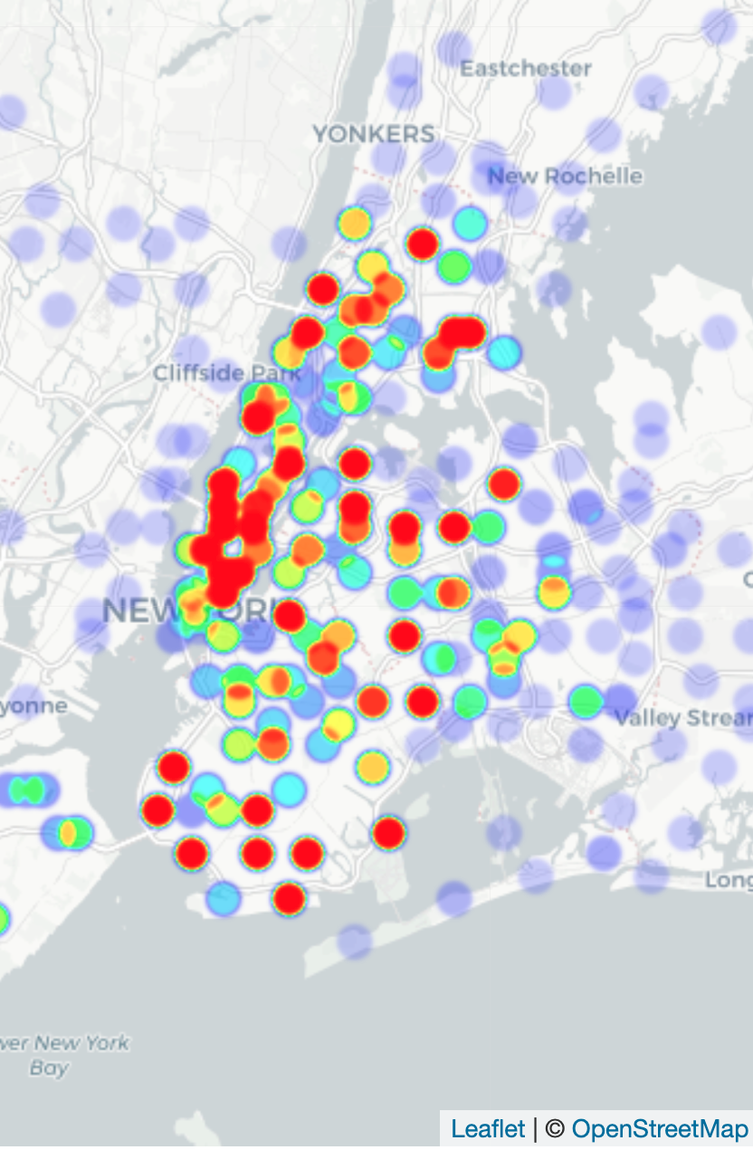
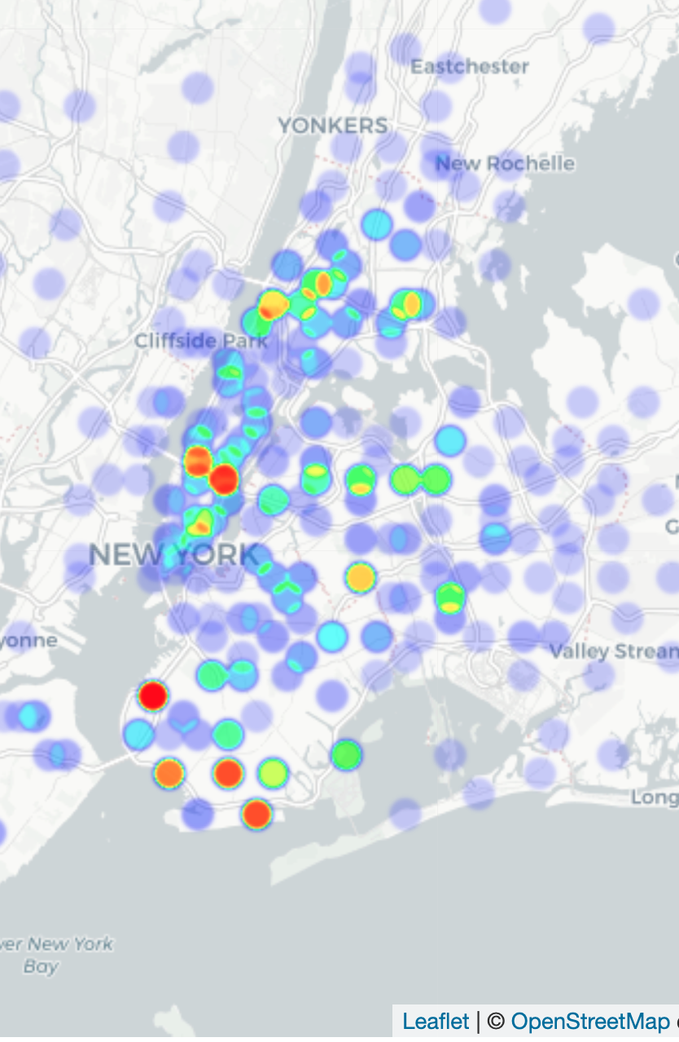
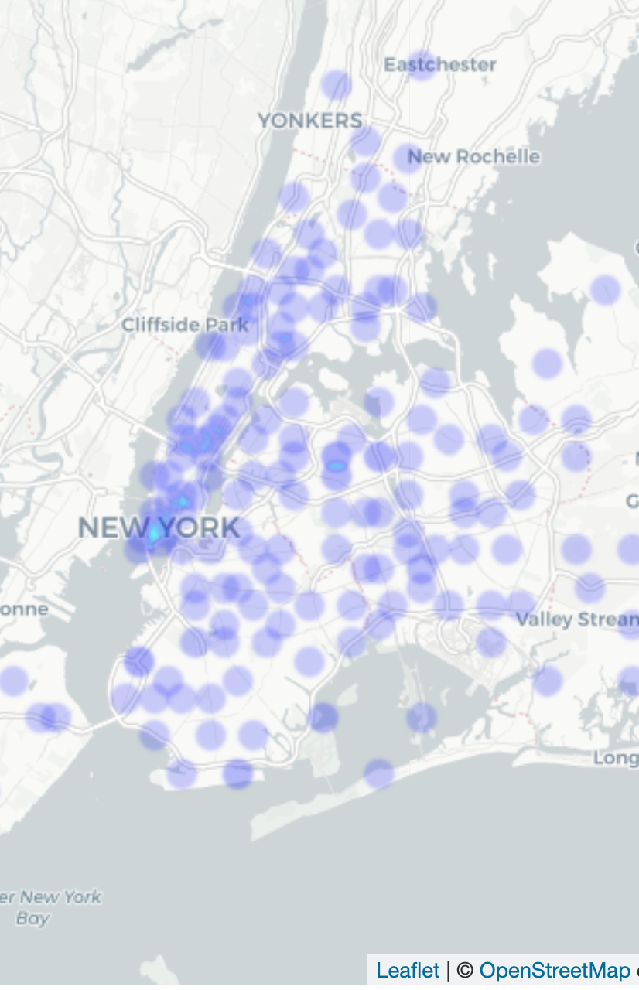
Data Information - Data Visualization
Heatmap of Licenses granted in 2018
Heatmap of Licenses granted in 2019
Heatmap of Licenses granted in 2020

Slide 8
02
Hypothesis Testing
Null Hypothesis
Alternate Hypothesis
Threshold
Welch’s T-testing

Slide 9
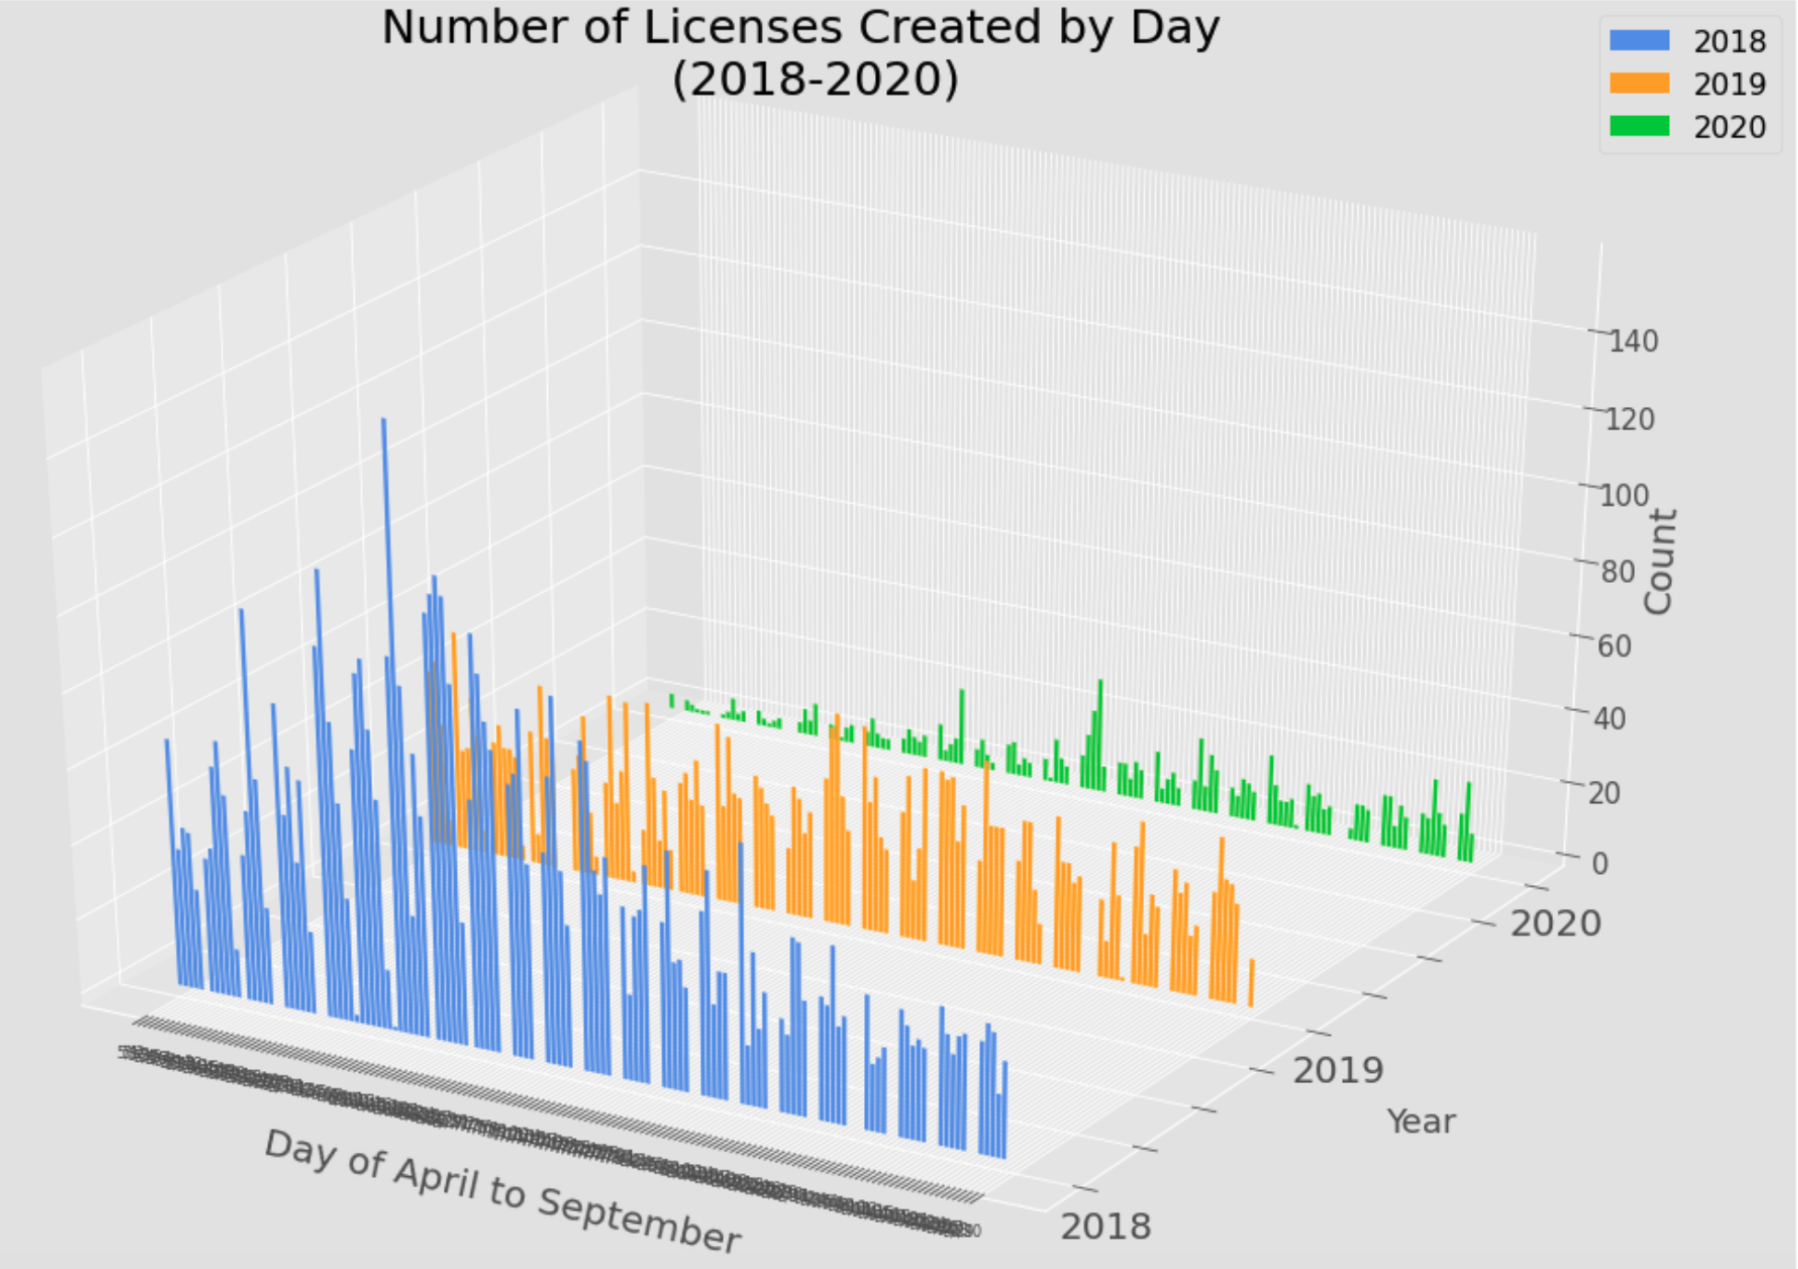
Hypothesis Testing
Statistically significant?

Slide 10
Hypothesis Testing
Null Hypothesis: The mean of licenses granted in 2020 has no change comparing to the mean of licenses granted in previous years(2018 and 2019).
Alternative Hypothesis: There is change between the mean of licenses granted this year and previous years(2018 and 2019).
Set significance level: α = 0.05
Method: Welsh's t-test

Slide 11

Hypothesis Testing
Welch’s T-test
T statistics: 14.678045591103883
P-Value: 3.2720431903438374e-32
P-value < α
Reject Null Hypothesis!

Slide 12
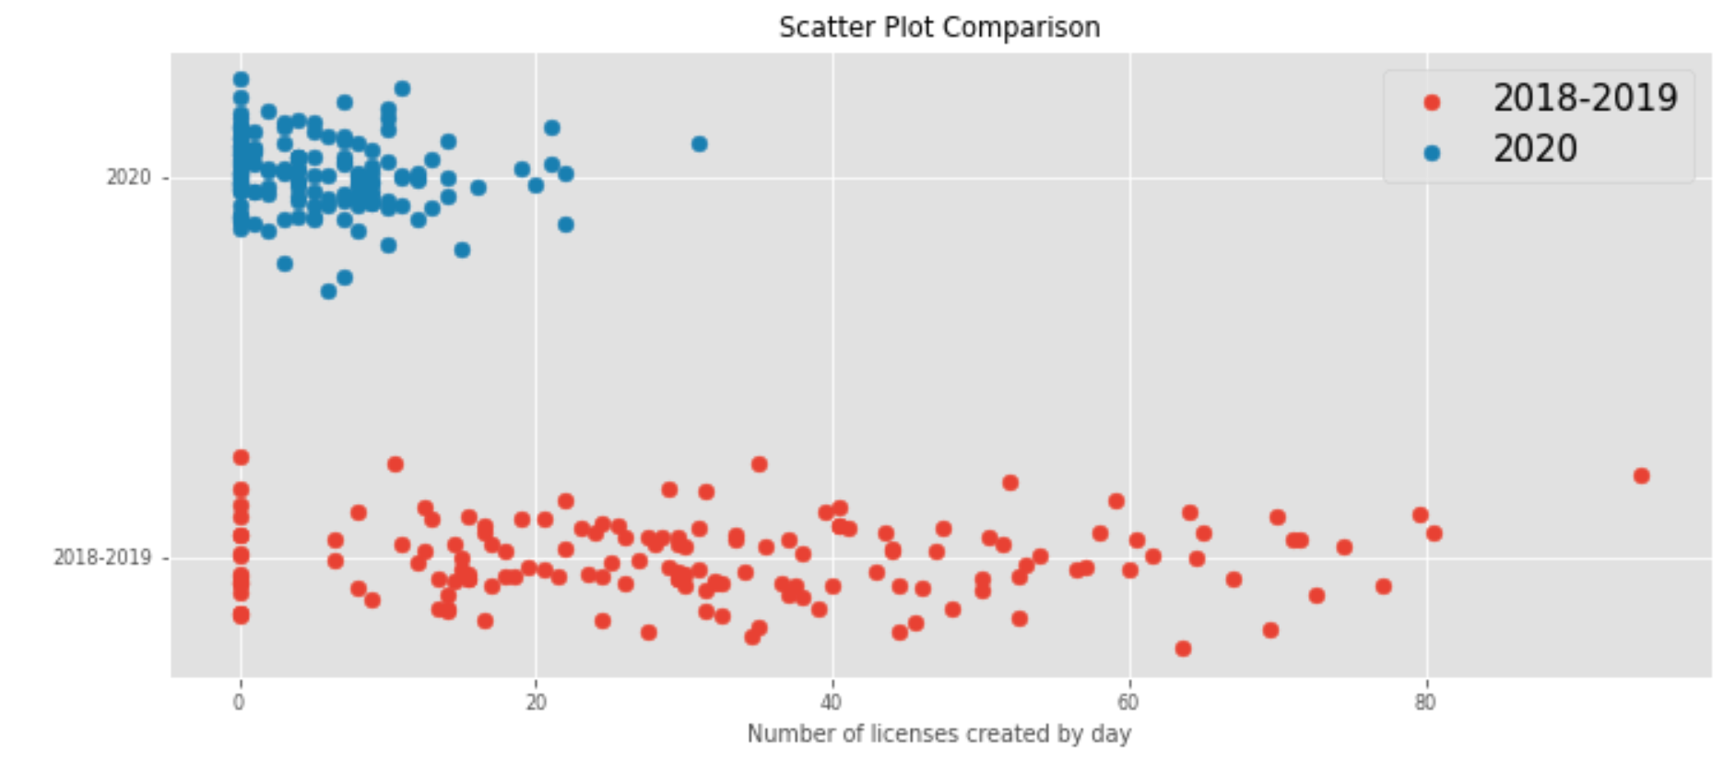
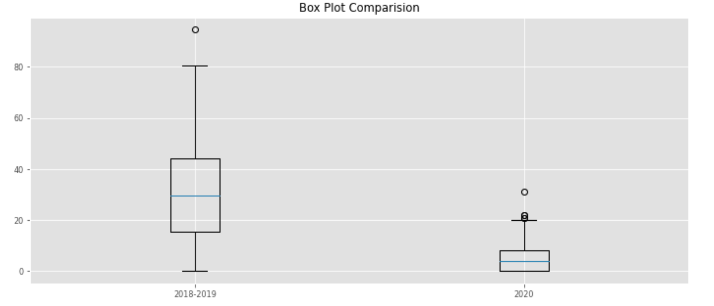
Hypothesis Testing

Slide 13

Conclusion
Due to the fact that we reject the null hypothesis, we have enough evidence to conclude that there is a significant drop of new DCA license being granted in 2020 comparing to the number of licenses being granted in 2008 and 2009.

Slide 14

Future Analysis
Analysis of changes in new licenses granted by different industry
Does COVID-19 impact the number of license granted in NYC this year?

Slide 15
Questions?
https://github.com/yinhang945/GalvanizeCapstone1

Slide 16
Reference
NYCOpenData -Legally Operating Business
https://data.cityofnewyork.us/Business/Legally-Operating-Businesses/w7w3-xahh

